Slide 1
Practical 06 (Friday 4pm) Group E
Australian Election Results
Michael Payne (45133956), Vincent Xu (44937113) Xiaotian Liu (44410573), Tianhao Tang(44030754)

Slide 2


Project Background
The Australian 2019 Federal and State elections were considered upsets my multiple media sources
Could this have been predicted? was the elections truly a surprising win?

Slide 3
Project objective
Highlight different socio-economic factors and how they differ between the electoral divide
Create Classifiers that can hopefully predict the election outcome based on our training data
Use factor analysis to attempt to find the best indicator of the outcome of an election.

Slide 4
Data Explanation
The data used is split into the following files, pulled from the election website. The clean data totalled to 973 Data points, while the unclean data totalled higher than 5000
Our tables and variables used are seen below:
NSW data
Ancestry.csv
Age.csv
Education.csv
Children.csv
Income.csv
Result.csv
NSWFull.csv
Federal data
FedAncestry.csv
FedAge.csv
FedEducation.csv
FedChildren.csv
FedIncome.csv
FedResult.csv
FedFull.csv

Slide 5
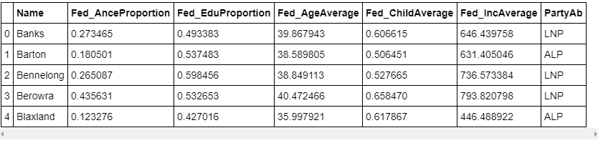
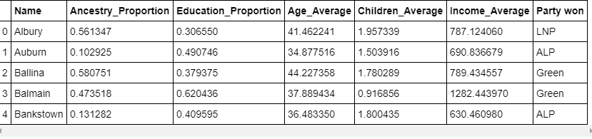
Closer Look at the data
Training data -FedFull
Testing data - NSWFull

Slide 6
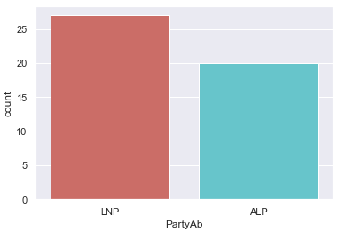
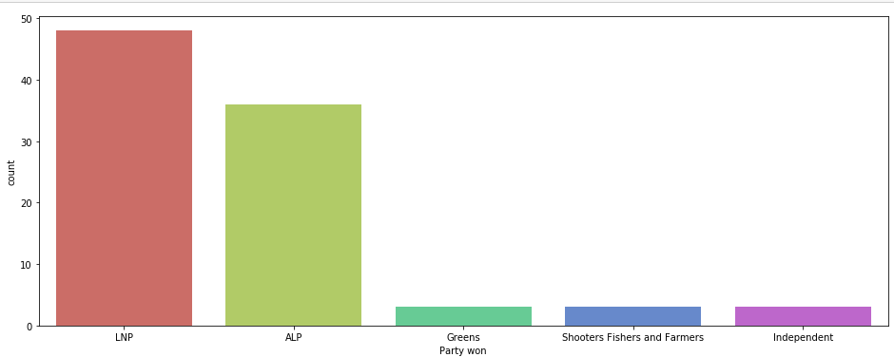
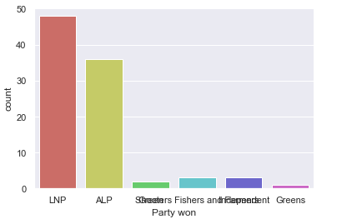
Closer Look at the data
Federal Result
NSW Result

Slide 7
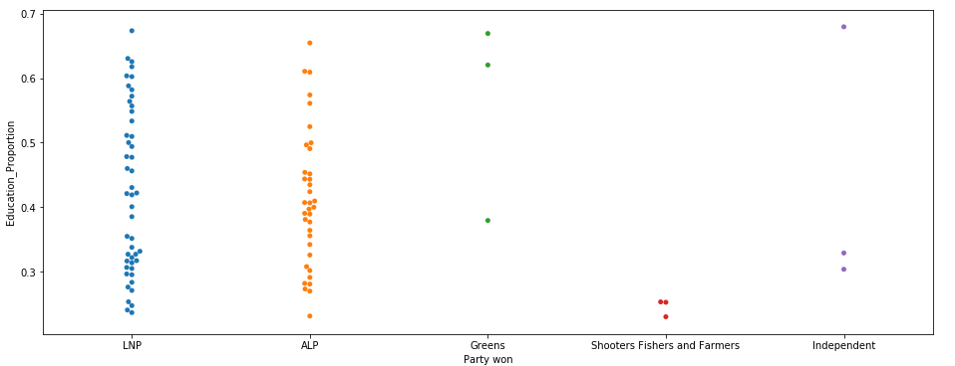
Differences in variables
Education

Slide 8
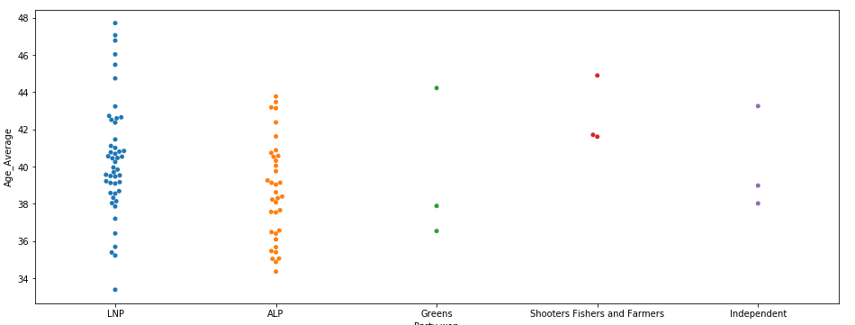
Differences in variables
Age

Slide 9
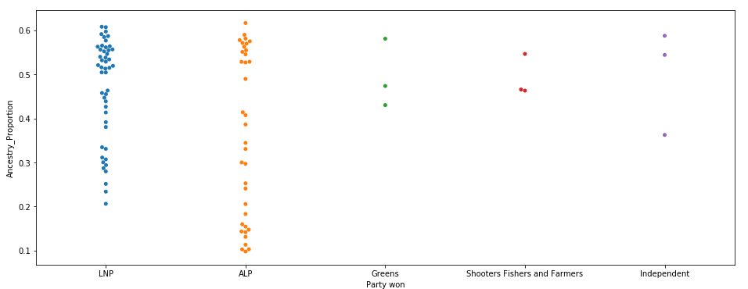
Differences in variables
Ancestry

Slide 10
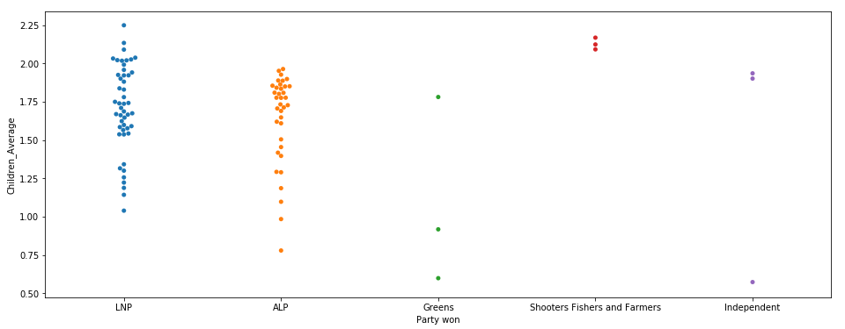
Differences in variables
Children

Slide 11
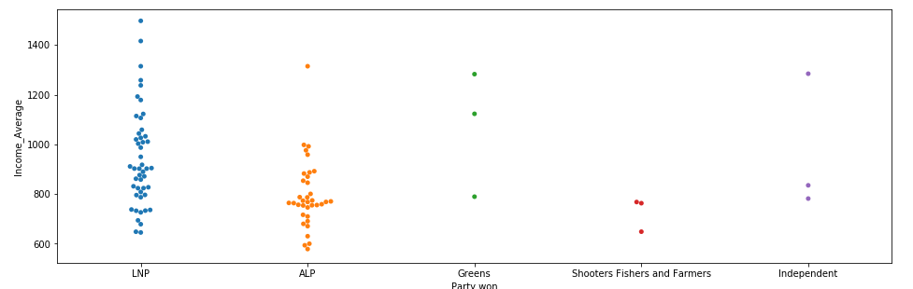
Differences in variables
Income

Slide 12

Classifiers
The next slides will go through the classifier results. The classifiers tested are
Logistic Regression
K Neighbours
Gaussian Naive Bayes
Decision Tree
Our Training set will be the federal data and electorates, and our testing set will be the New south wales results

Slide 13
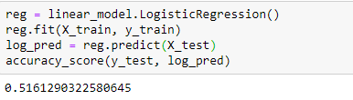
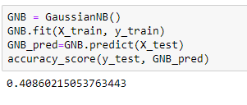

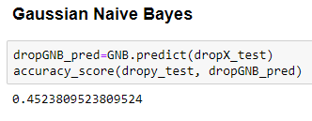
Logistic Regression Gaussian Naive Bayes
Logistic Regression result suffers due to the very non linear nature of the data
Gaussian Naive Bayes suffers due to the variables being too dependant upon each other

Slide 14
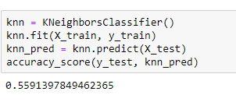
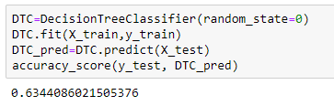


Kneighbours Decision Tree
Kneighbours suffers due there being too many variables such that groups are hard to classify
Decision Tree performs well due the heavy weight of single variables, allowing it to bias heavily the decisions towards them

Slide 15
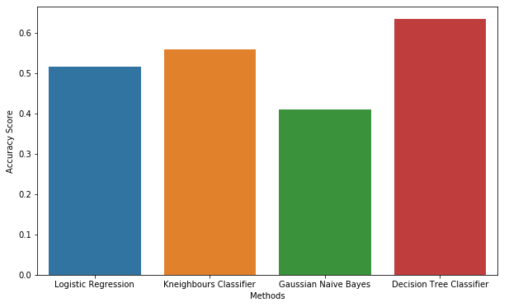
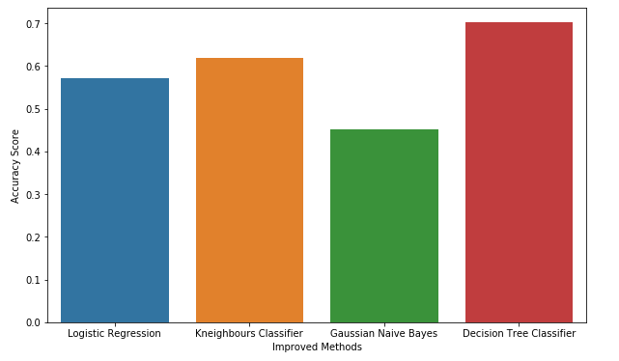
Classifier Analysis

Slide 16

Feature Analysis
We will perform our feature analysis from our Decision Tree, due to it performing the best
The results from this implies that number of children is the most important feature, followed by ancestry, and income, with Age and Education appearing irrelevant (within a two-party context)

Slide 17
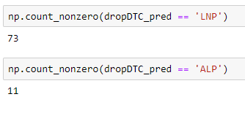
Response Checking
As can be seen, our best classifier, Decision Tree, tended to heavily over-fit, leading to a heavy bias in Liberal-National Coalition responses

Slide 18
Summary
Using our classifiers, we were capable of successfully classify 70% of electorate responses. This is a success, being a large amount higher than expected 50% from guessing.
This is not to say that our classifiers are not significantly flawed. Using only a limited number of variables leaves a lot that the classifier can not account for, and it would need improvement before being usable to truly accurately predict election results.

